Slide 1
views

Slide 2
What are views?
database view is a virtual table or logical table which is defined as a SQL SELECT query with joins. Because a database view is similar to a database table, which consists of rows and columns .
In other words, VIEWS are nothing but SELECT Queries.

Slide 3
Views syntax
Create view `view name` as select statement;
"CREATE VIEW `view_name`" tells MySQL server to create a view object in the database named `view_name`
"AS SELECT statement" is the SQL statements to be packed in the views. It can be a SELECT statement can contain data from one table or multiple tables.

Slide 4
Eg:
CREATE VIEW ‘v_pricelist’ as select '00' AS `CODE`,`idata`.`BRCODE` AS `BRCODE`,`idata`.`ITEMCODE` AS `ITEMCODE`,`idata`.`PARTCODE` AS `PARTCODE`,`idata`.`RATE` AS `PRICE` from `idata` where ((`idata`.`CANCEL` = 'No') and (`idata`.`DOCDATE` = (select max(`i`.`DOCDATE`) from `idata` `i` where (`i`.`ITEMCODE` = `idata`.`ITEMCODE`))));

Slide 5
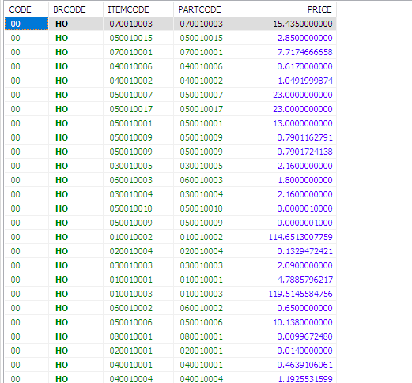
HOW TO USE VIEW?
Syntax:
SELECT * FROM ‘viewname’;
Eg:
SELECT * FROM ‘v_pricelist’;

Slide 6
DROP VIEW
DROP is used to delete view from the database which is no longer required.
SYNTAX:
DROP VIEW ‘viewname’;
Eg:
DROP VIEW ‘v_pricelist’;

Slide 7
If you drop or rename tables to which a view references, MySQL does not issue any error. However, MySQL does invalidate the view
A simple view can be updatable. A view created based on a complex SELECT statement with join
, subquery, etc., cannot be updatable

Slide 8
UPDATABLE VIEW
Views are not only query-able but also updatable. You can use INSERT,UPDATE or DELETE statements in the Updatable view.
To create an updatable view, the SELECT statement that defines the view must not contain any of the following elements:
Aggregate functions such as MIN, MAX, SUM, AVG, and COUNT.
DISTINCT
GROUP BY clause.
HAVING clause.
UNION or UNION ALL clause.
Subquery in the SELECT clause or in the WHERE clause that refers to the table appeared in the FROM clause.

Slide 9
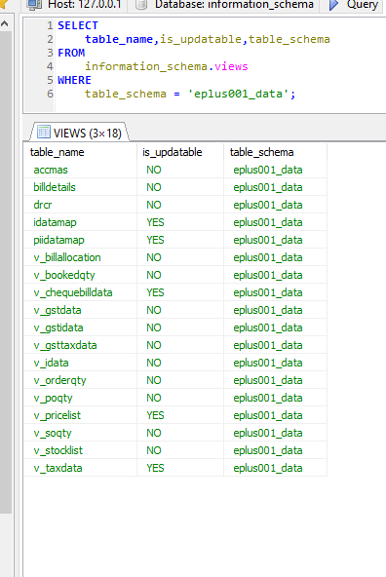
CHECKING UPDATABLE VIEW INFORMATION
You can check if a view in a database in updatable by querying the is_updatable column from the views table in the information_schema database
Syntax:
SELECT
table_name,
is_updatable
FROM
information_schema.views
WHERE
table_schema = ‘database_name';

Slide 10
Removing rows through the view
use the DELETE statement to remove a row
Syntax:
DELETE FROM VIEW_NAME WHERE CONDITION;

